Slide 1

Cambridge, MA • [insert date] • Harvard Presentation
Youth Envision| Professionals Assist|
Africa is Transformed

Slide 2


Slide 3
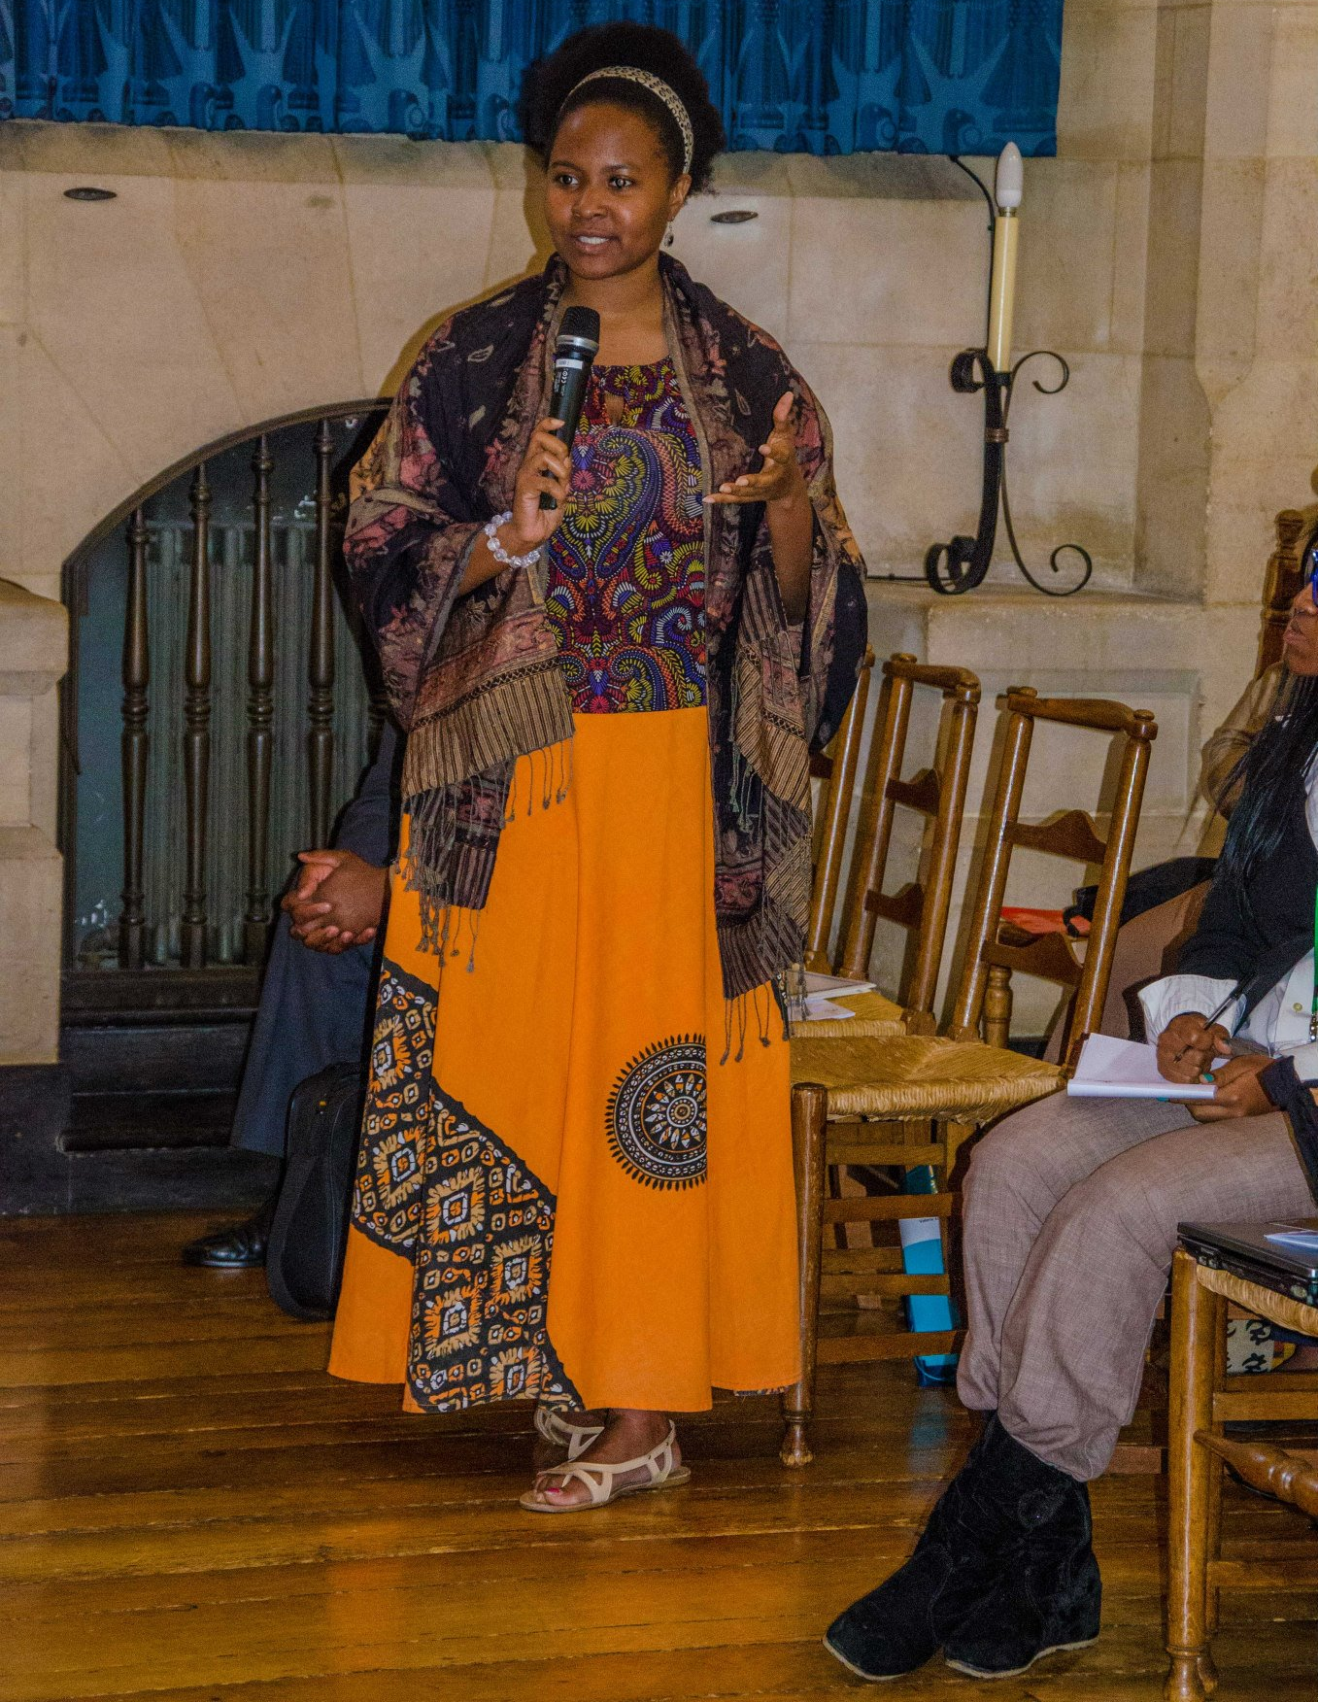
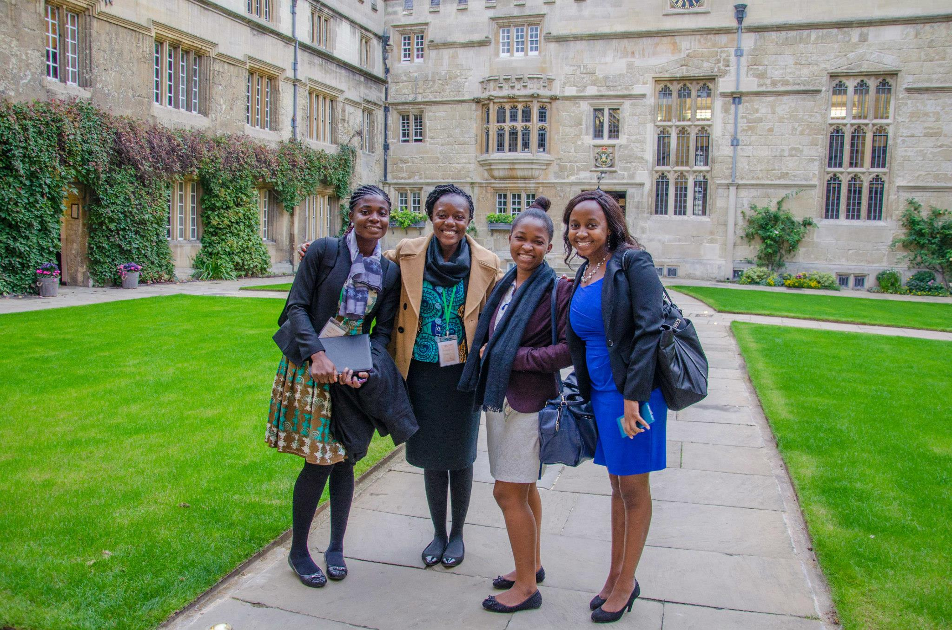
Who are we?
We are an international network of African youth who want to make a positive impact on the African continent.
We function as a powerful platform for ground-level youth-based solutions.
We eagerly cross cultural and national boundaries to raise awareness, collaborate with like-minded peers, and mento young Africans with leadership potential to support them in realizing their short and long term goals.
YALDA is truly “By Africans, for Africa!”

Slide 4




We are accredited internationally
Our official headquarters are located in Gaborone, Botswana
We are registered as a Non-Governmental Organization in Ghana, Kenya, Nigeria, South Africa and Uganda
We are the only African youth organization recognized by the United Nations Economic and Social Council
We enjoy 501(c)(3) and public charity status in the United States

Slide 5
We champion the African youth agenda
We foster communication and productive collaboration between African students, youth and leading professionals
We raise awareness of the critical need for youth participation in the African development project
We nurture leadership capabilities and technical skills amongst African youth
We integrate, operationalize and resource visions to build new sectors and industries in Africa

Slide 6




Why are we important?
African youth have limited resources i.e., information, guidance, and human capital
Young Africans are also economically and politically disenfranchised
By connecting young Africans with professionals, mentors and peers, YALDA aims to develop the leadership capabilities of Africans as change agents
YALDA will build an international network of empowered young leaders who are decision makers, thought leaders, entrepreneurs, community organizers and active citizens of African economies, societies and polities

Slide 7
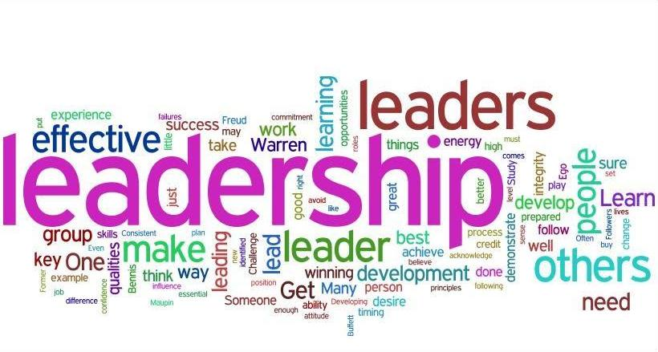
We are a decentralized organization
Board of Advisors
International Executive Committee
General Membership
Committees

Slide 8
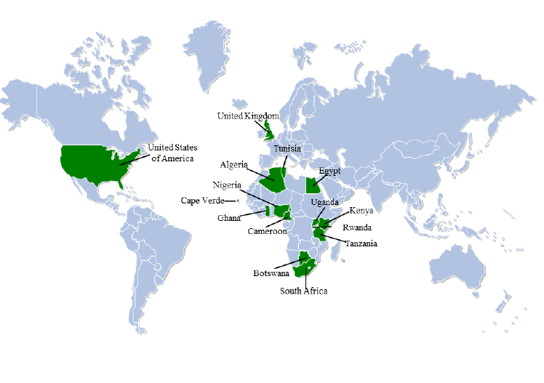
We have a presence in over 15 countries
Algeria
Botswana
Cameroon
Cape Verde
Egypt
Ghana
Kenya
Nigeria
Morocco
Rwanda
South Africa
Tanzania
Tunisia
Uganda
United States
United Kingdom

Slide 9
We engage youth through many projects
2008: Stand Up Against Poverty Campaign (On-going)
2010 Conducting Model African Union (On-going)
YALDA International Conferences in
  2006: Egypt - “An African Course in Development: Youth Redefining Leadership.”
  2008: Uganda -“Overcoming Obstacles on the Continent and Beyond.”
  2011: Botswana -“Spotlight on Africa: Youth Owning the Continent’s Development Wave”
  2012: Nigeria -“Innovation and Creativity for a better Africa: Implementing Your Dreams”
2012: YALDA against brain drain & for creating opportunities (February)
2012: Financial Literacy Program with Barclays Botswana (October)
2013: “Adopt an Idea” Initiative in Nigeria (February)
2013: Adopt A school Campaign Activities (On-going)
2013: Voice Africa’s Future Campaign (On-going)
2014: Do Something Campaign in Botswana (On-going)
2014: “Intercollegiate Model African Union Summit” in United Kingdom (September)
2015: Action2015 Campaign (On-going)

Slide 10
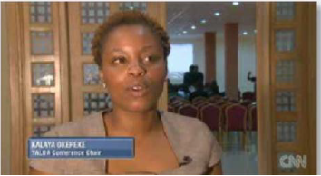
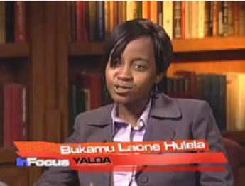
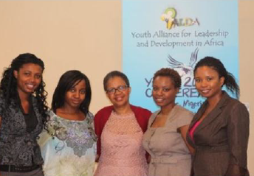
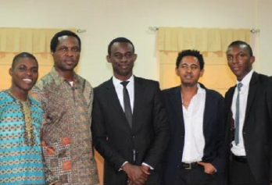
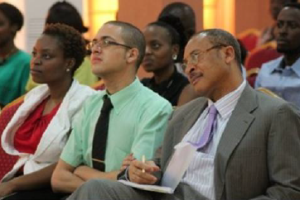
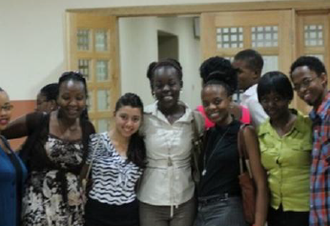

Slide 11
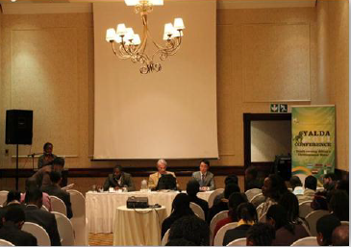
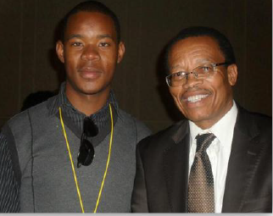
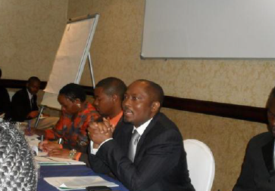
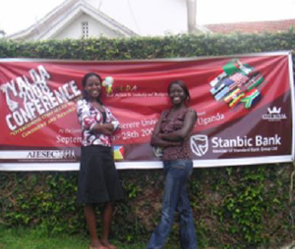
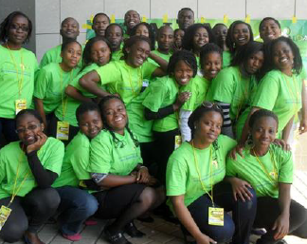
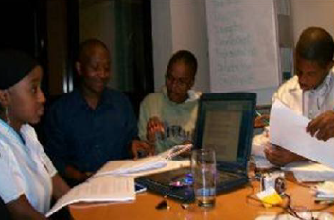

Slide 12
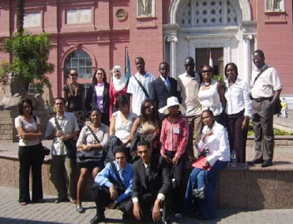
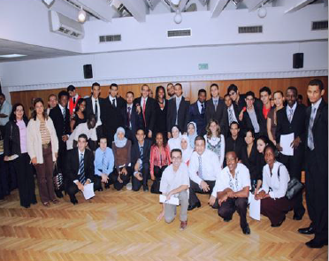

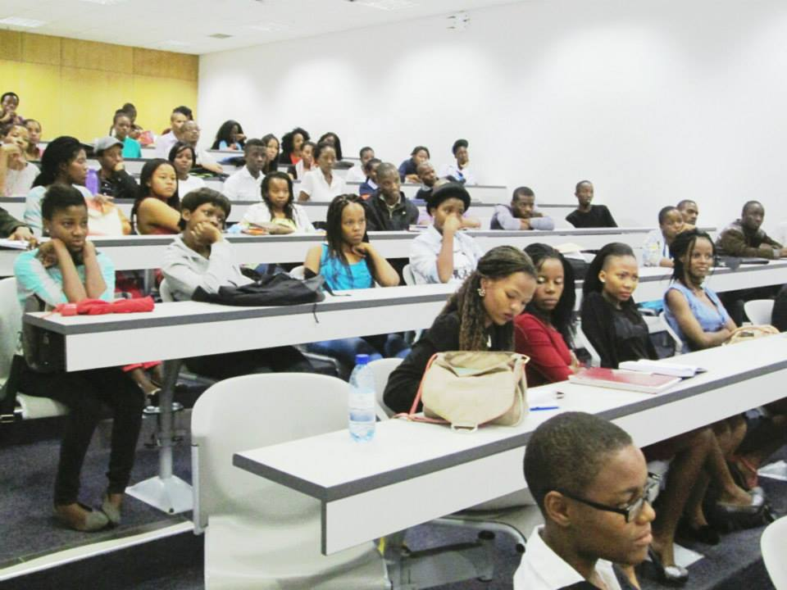
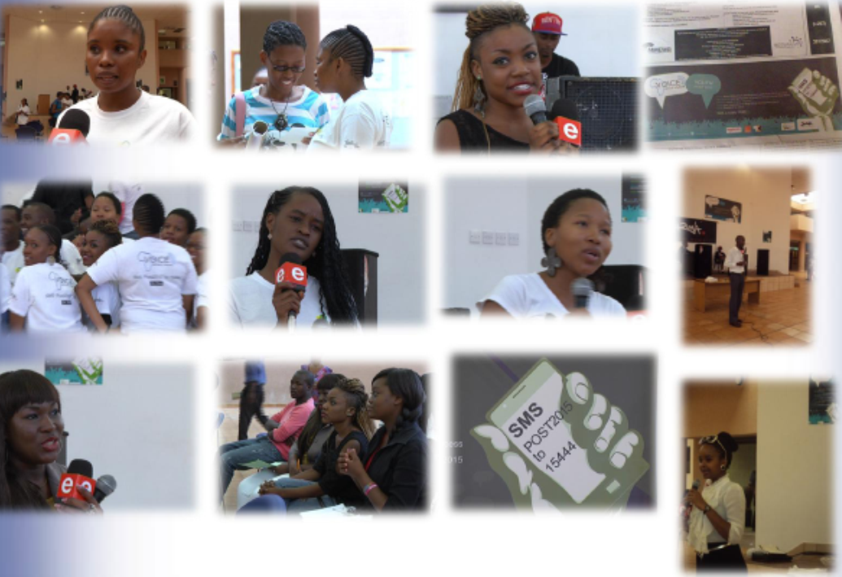

Slide 13













Our partners

Slide 14
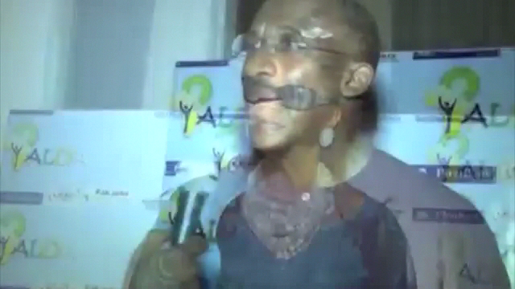
What do our advisors have to say?

Slide 15
We continue to look ahead
Do Something Campaign Partnership
“Dragon’s Den” YALDA TV Program in South Africa
CT4D – Culture and Technology for Development
  By adopting technology, photography and film making, young people across Africa can virtually share their rich experiences in advocacy and starting enterprises
Activate Africa
  Systematic programme that leads young people from ideation to implementation of their ideas over a period of time
  Similar is structure of YALDA conference
Kenya Conference 2015 – “What Africa Needs Now: Youth Creating Employment
Intercollegiate Model African Union 2016 -- Year of Agriculture

Slide 16
So what is our vision for Harvard?
Workshops to help members improve the leadership skills for working in Africa
Seminars on development in Africa and opportunities for impact
Preparation for IMAUS Botswana January 2016 and YALDA Cameroon i-Boot Camp October 2016
  Fundraising and Speaker invites
Treks to the United Nations in New York and World Bank events or conferences in DC
  Opportunity to represent Africa’s youth and submit position papers to entities upon their request
Magazine development

Slide 17
How do you join the leadership team?
Form an Executive Board looking to fill the following 5 positions:
  Assistant Executive Director/ Secretary
  Financial Director/ Treasurer
  Local University Coordinator/ Outreach Chair
  Multi-media Specialist/ Communications Chair
  Inter-governmental Organisations Liaison
Kennedy will send out an email to the group for anyone who is interested in a leadership position for a meeting this Sunday!
Youth Alliance for Leadership and Development in Africa

Slide 18



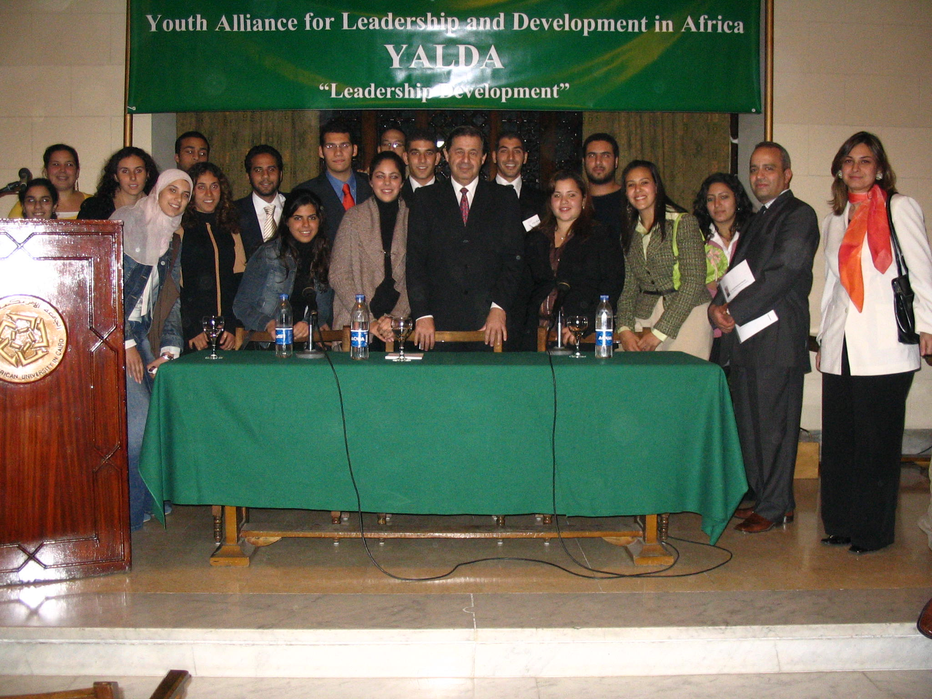

How do you become a member?
Youth Alliance for Leadership & Development in Africa
@yaldafrica
yaldafrica@gmail.com
info@yaldafrica.org
www.yaldafrica.org
“100% YALDA pride, devotion & commitment to a better Africa”

